Slide 1
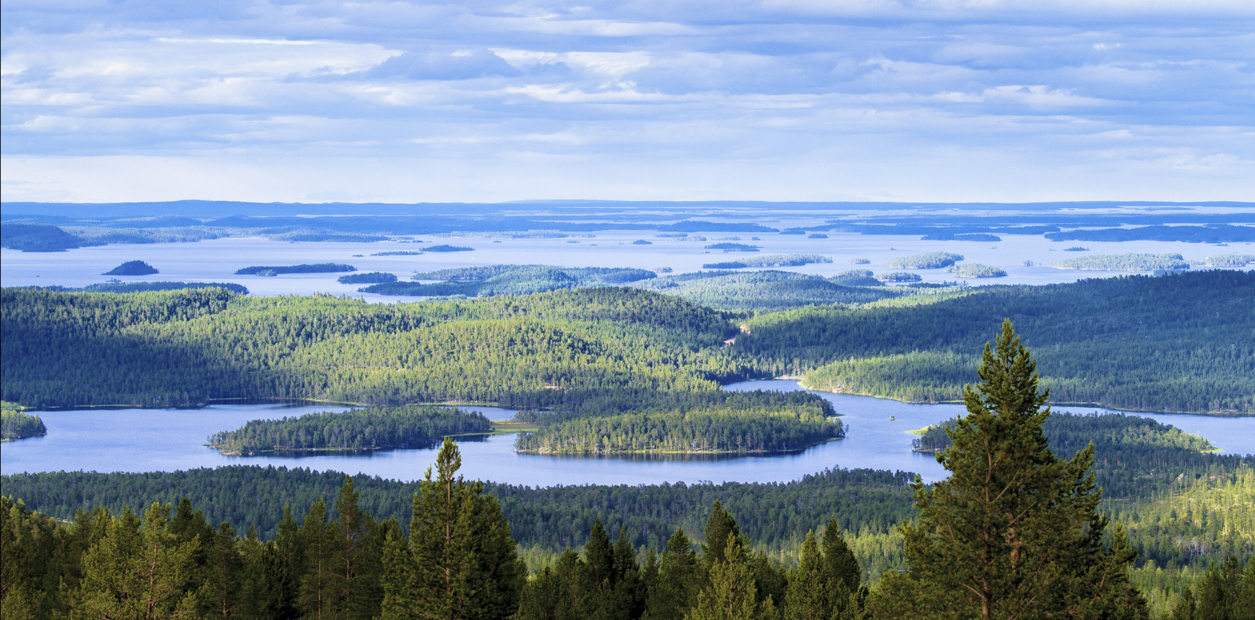
Inari municipality – Strategy 2030
Approved by the Municipality Council 11.3.2024 §21

Slide 2
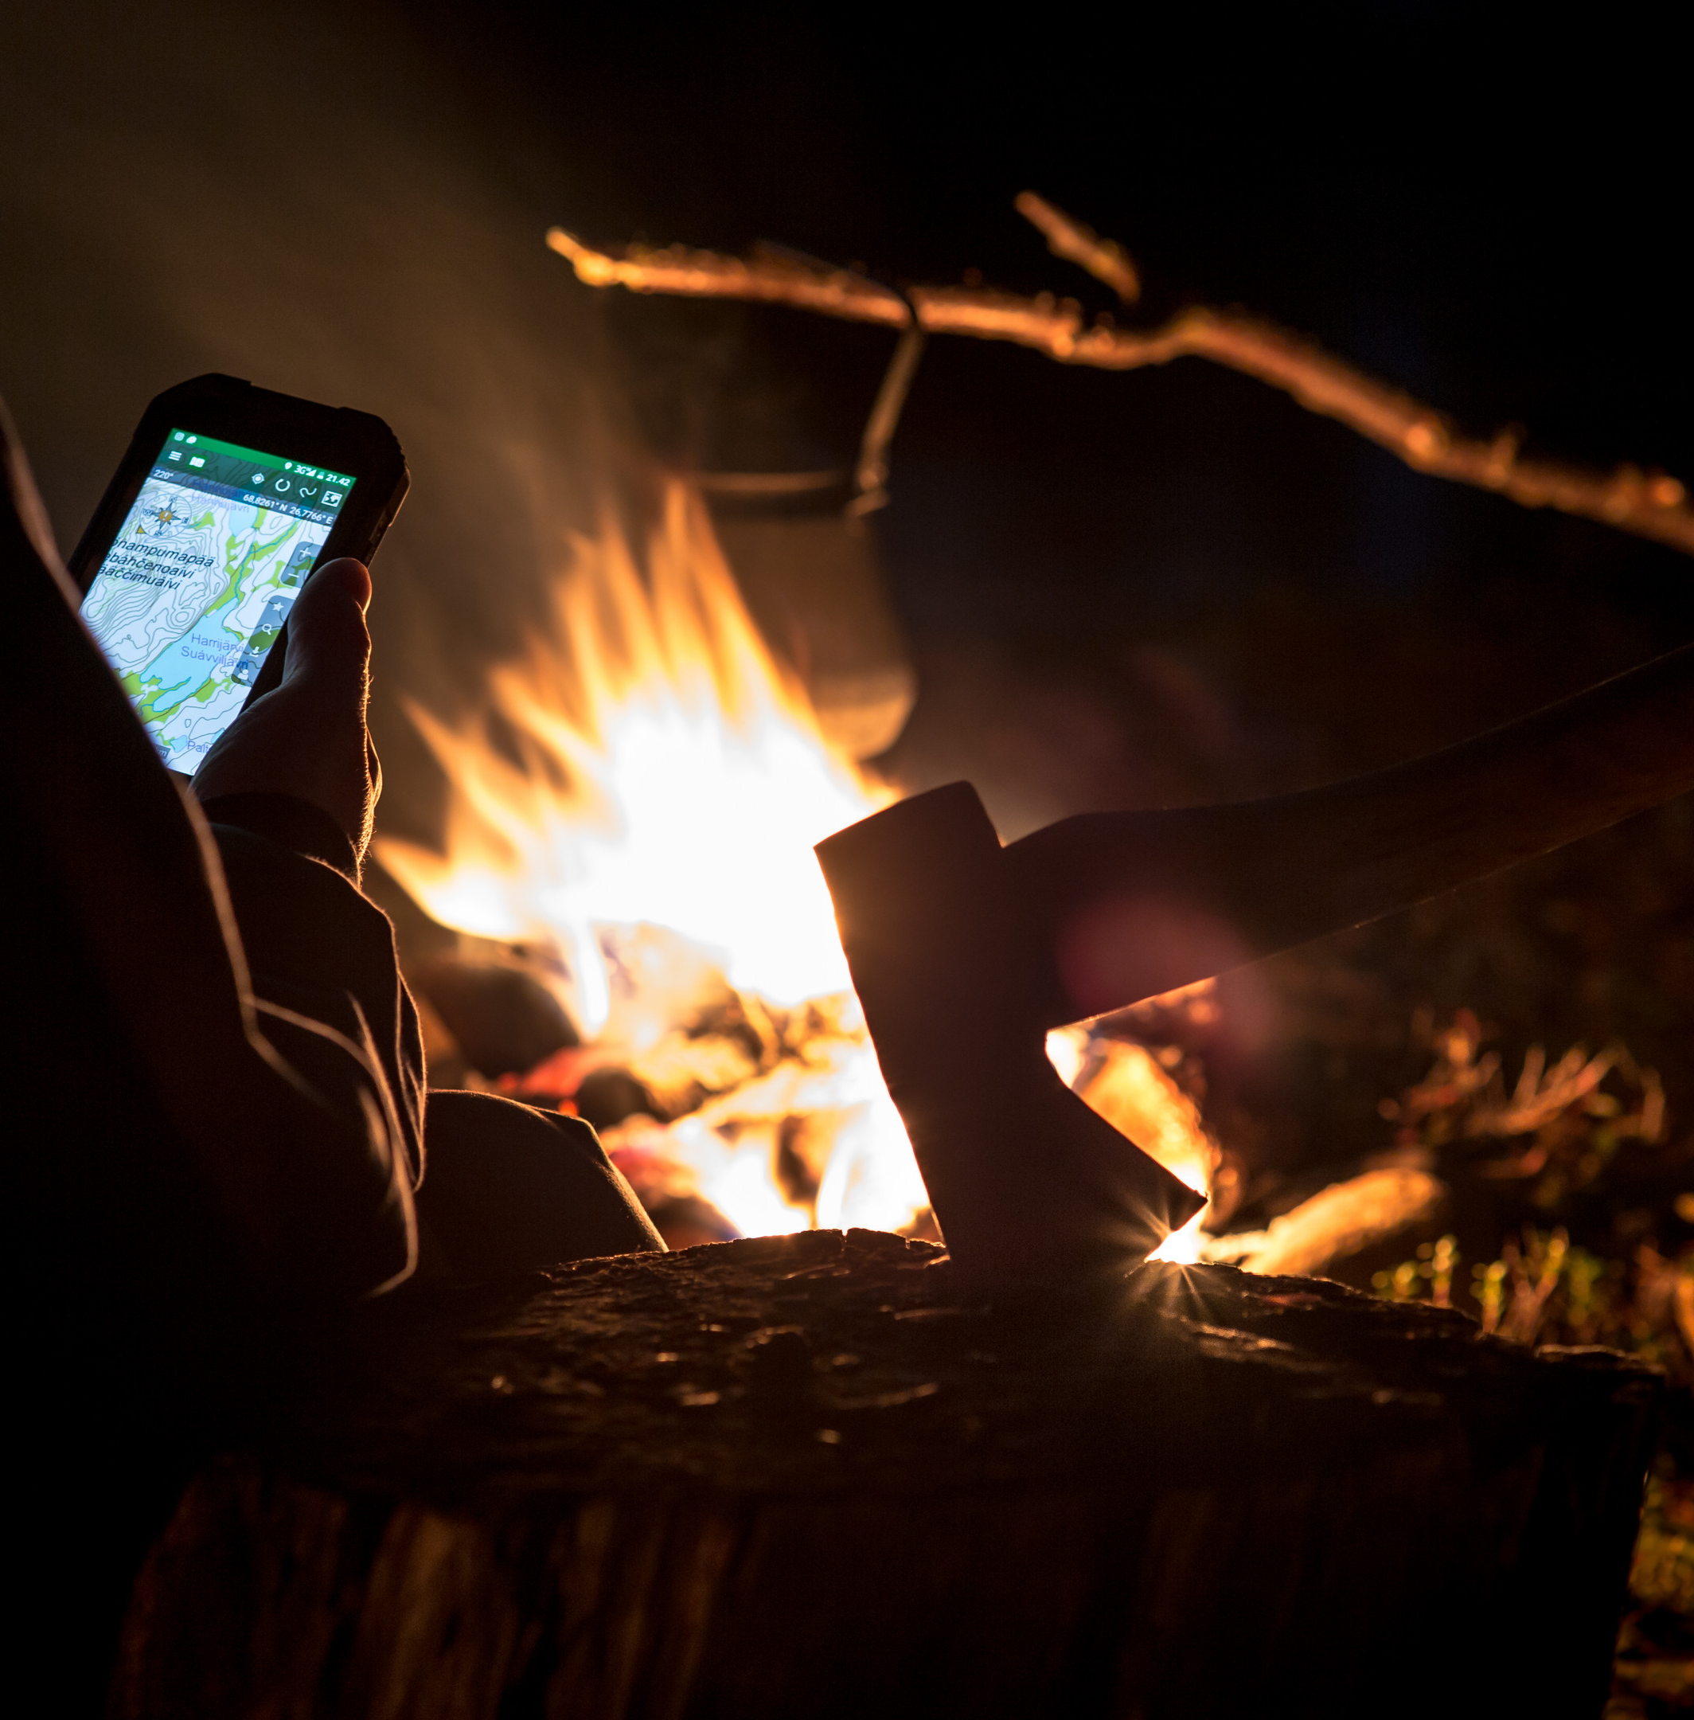

Vision and Mission
INARI – Mighty by nature
INARI – A responsible promoter of vitality and good life

Slide 3


Strategy 2030
  Inari's unique natural environment serves as the cornerstone of all endeavours. We use natural resources responsibly, fortifying our natural capital.
  The vitality of our municipality rests upon well-managed, evolving industries. We diversify economic activities for year-round.
  Socially sustainable growth and understanding the significance of intergenerationality are fundamentals for a fulfilling life. We foster community spirit, enhance resident safety, and prioritize the well-being of our youth.
  Sámi heritage is a valuable part of Inari municipality.
  By collaborating with other stakeholders in the Sámi region, we increase the prominence of Sámi languages and culture.

Slide 4
Our values
Values | Bringing our values to life
Community-Oriented | We operate with fairness and treat each other equally In all situations, we operate openly, in a solution-oriented manner, and with respect for others Ensuring safety throughout the entire municipality is our priority We value family-friendliness, dignified aging, and a business-friendly environment The municipality’s staff actively participates in development
Local | Localness is a collective effort – it involves inclusivity and engagement, consideration and respect for others, as well as hospitality Together, we aim to increase the use of local products and services We seek solutions to increase the processing degree of local services and products Residents, local businesses, and organizations are the municipality's greatest resource
Courageous | We dare to make clear and timely decisions We are internationally active participants We see the positive aspects of things and boldly seek practical solutions We encourage bold experimentation and learn from mistakes We develop the municipality's organization to meet future needs
Responsible | We secure sustainable development opportunities for current and future generations We take responsibility of the sustainability of nature, economy and people As decision-makers, and as an employer, we act responsibly We keep our promises

Slide 5
Inari – Mighty by nature
Sustainable promoter of vitality and good life
COMMUNITY-ORIENTED – LOCAL – COURAGEOUS – RESPONSIBLE
Priorities of the strategy
NATURE
Sustainable use of nature
VITALITY
Diversifying economic activities for year-round
SÁMI CULTURE
Increase the prominence of Sámi languages and culture
GOOD LIFE
Socially sustainable growth
Economic activities -program Well-being, health and safety program Language policy program (Sámi language strategy) Land policy program
Advocacy TOP 8, Influential communication

Slide 6
Priorities of the strategy
Priority of the strategy | Operational goal | Top measures
NATURE | Sustainable use of nature | Increasing the value of natural capital Addressing climate change Promoting circular economy Guided and marked trails Sustainable land use
VITALITY | Diversifying economic activities for year-round | Promoting investments Strengthening and diversifying the economic structure Acquiring skilled workforce Responsible year-round tourism Nature-based northern industries Effective workforce and business services Accessibility
SÁMI CULTURE | Increase the prominence of Sámi languages and culture | Sámi culture is a precious part of everyday life in Inari Strengthening the visibility of Sámi languages Improving the availability of Sámi-speaking employees Enhancing Sámi-language services Good population relations Constructive dialogue with Sámi stakeholders
GOOD LIFE | Good life - Socially sustainable growth | Efficient services Well-being of children and youth Well-being and quality of life for the elderly Collaboration with the Lapland Well-being Area Smart accessibility Supporting villages based on their own needs and circumstances Conducting pre-assessments for significant projects

Slide 7
Strategy monitoring
Priority of the strategy | Operational goal | Monitoring (indicators)
NATURE | Sustainable use of nature | Development of recycling rate (%) Relevant sustainable development metrics been adopted in urban planning, Yes/No Has a climate plan been drafted? Yes/No Results of citizen surveys (residential comfortability and satisfaction with services)
VITALITY | Diversifying economic activities for year-round | Population development of the municipality (%) Monthly occupancy rate of accommodation capacity (%) Municipal group investment program based on economic development program, Yes/No Results of Finland’s entrepreneur barometer Ecosystem plan for nature-based industries prepared, Yes/No
SÁMI CULTURE | Increase the prominence of Sámi languages and culture | Implementation of state grants in early childhood education and teaching (€/year) Amount of Sámi language education and early childhood education, and Sámi language teaching (actual hours and number of children) Satisfaction with Sami language services (survey) Expenditure on translations, interpretation, announcements, and communication in euros and personnel resources/year Annual analysis of indicators of the language policy program (language strategy), Yes/No
GOOD LIFE | Good life - Socially sustainable growth | Development of well-being and health promotion coefficient (HYTE coefficient) Metrics Development of results from the school health survey Percentage of children and youth engaged in hobbies Percentage of children and youth with friends Number of organized trainings (village safety) Number of pre-decision impact assessments (EVA count)

Slide 8
Advocacy and Influencing Top 8
1. Fostering the development of building residential and commercial spaces
2. Energy policy (security of supply, new energy forms, solar power, bioenergy)
3. Advancement of year-round tourism and safety, "tourist tax“
4. Promotion of multi-locality
5. Strengthening funding and activities for Sámi languages and culture
6. Accessibility and transportation; air travel routes, efficient travel chains, and better bus connections within the municipality. Especially Seututie 955 and Valtatie 4.
7. Regional availability of social and healthcare services
8. Securing the functionality and economic stability of workforce and business services
The goal of defining these TOP 8 areas in advocacy and influence is to advance strategically important matters for the municipality, summarize the message of the municipality, identify relevant targets for advocacy efforts, and outline specific steps.

Slide 9
Influential communication
Services, decisions, and communication with citizens
Strategic communication and informing , Advocacy
Internal communication for personnel and group companies
Communication with stakeholders (entrepreneurs, funders, etc.)
Municipal marketing
The purpose of communication in Inari municipality is to transparently and positively share information about municipal matters while maintaining constructive and solution-oriented interaction with residents and various stakeholders.
In municipal marketing, emphasizing Inari’s existing strengths and concretizing the advantages related to its location are important. An updated communication plan covering various aspects of impactful communication is developed, and its implementation is systematically monitored.

Slide 10

Action Plan 2024-2026
To advance the strategic focus areas

Slide 11
Nature – Sustainable use of nature
Operational goal | Top measures | Monitoring (Indicators)
INCREASING THE VALUE OF NATURAL CAPITAL | Identifying natural values and dependencies in decision-making and tendering Implementing zoning based on comprehensive biodiversity surveys and participation, to safeguard biodiversity and account for cultural landscapes Actively exploring alternative long-term solutions for heat production | Percentage of tenders incorporating environmental criteria (%) Whether relevant sustainability indicators have been adopted in planning, Yes/No Area (m²) and proportion of protected areas in the municipality's land area
RESPONDING TO CLIMATE CHANGE | Developing a climate action plan for the municipality Preparing plans for environmental construction, maintenance, and upkeep with principles of sustainability (low-carbon) Adapting and preparing for climate change locally as much as possible (flooding, snow and rainfall, extreme cold) | Climate action plan has been made, Yes/No Development of maintenance costs Extreme weather phenomena scripted for in the contingency plan, Yes/No
PROMOTING CIRCULAR ECONOMY | Increasing recycling rates through active collaboration with the Lapin Jätehuolto kuntayhtymä Encouraging efficient utilization of raw materials Providing guidance and information in collaboration with schools, early childhood education, and waste management authorities | Development of recycling rate (%) Developing plan produced, Yes/No Number of completed educational campaigns per year
GUIDED AND MARKED TRAILS | Considering both local needs and customs as well as the needs of tourists in nature tourism destinations, while preserving untouched nature and concentrating trails Implementing guided routes to nearby natural areas and recreational areas, considering diverse usage needs and accessibility | Feedback on the condition and maintenance of routes (summary after each season) Targeted usage rate counters
SUSTAINABLE LAND USE | Identifying regional characteristics and development needs; Ivalo, Inari, and Saariselkä, as well as villages, and conduct comprehensive area-wide assessments as the basis for detailed planning (Master Plan) Considering social sustainability in land use planning throughout the municipality Responding to diverse and sustainable plot offerings to meet the needs of businesses, public functions, and residential construction Updating the land use plan for Saariselkä | Results of citizen surveys (residential comfortability and satisfaction with services) Comparison between completed regional comprehensive assessments and the plan for creating area surveys Update of the development plan for Saariselkä, Yes/No Number of newly plotted plots per year Actual construction per year

Slide 12
Vitality – Diversifying economic activities for year-round
Operational goal | Top measures | Monitoring (Indicators)
FOSTERING THE INVESTMENTS | Defining a common vision for targeted investments Promoting residential and commercial property investments Increasing the supply of commercial spaces and diversifying the use of properties | Municipal group investment program prepared, Yes/No Number of new building permits issued annually
STRENGTHENING AND DIVERSIFICATION OF THE ECONOMIC STRUCTURE | Supporting the production of goods and services by local businesses Attracting new businesses to the area, for example, testing, audiovisual production, assembly, or other industrial activities Strengthening cooperation in education and research (including secondary education, universities, and research institutions) Utilizing research findings in the development of industries | Evolution of corporate revenue streams Annual count of newly established enterprises within the region New initiatives in educational institution collaboration
SECURING SKILLED WORKFORCE | Investigating labor needs and ensuring the permanence of the workforce Increasing the number of jobs around Sámi languages and Sámi-speaking workforce Developing recidential and service solutions for employees Targeting municipal marketing towards returning residents | Development of the municipality's population (%) Count of employees receiving language supplement Count of individuals awaiting housing
RESPONSIBLE YEAR-ROUND TOURISM | Aiming year-round tourism and longer stays in the region Developing responsible and climate-smart tourism services and structures (including trails and events) Supporting tourism marketing and enhancing collaboration in the tourism sector | Duration of stay Monthly occupancy rate of accommodation capacity (%) Initiatives supporting sustainable tourism
NATURE-BASED NORTHERN INDUSTRIES | Building an ecosystem for nature-based industries (reindeer, fishing, natural products, handicrafts, well-being) Increasing the level of product processing and utilizing opportunities in the circular economy Promote business and testing activities that take advantage of the natural conditions of the North | Ecosystem plan produced for nature-based industries, Yes/No Degree of products processing Number of development projects
FUNCTIONAL WORKFORCE AND BUSINESS SERVICES | Conceptualizing business services and developing network collaboration (entrepreneurial organizations, advisory bodies, and funders) Providing advisory services for start-ups and developing businesses Enhancing workforce services | Net number of businesses A vitality agreement with the entrepreneur organization, Yes/No Results of the Finnish Entrepreneurship Barometer Amount of applied business grants (€)
ACCESSIBILITY | Increasing the number of air route connections Promoting responsible travel chains Improving telecommunications connections | Number of direct flight connections Coverage of telephone and internet connections

Slide 13
Sámi culture - Increase the prominence of Sámi languages and culture
Operational goal | Top measures | Monitoring (Indicators)
SÁMI HERITAGE IS A CHERISHED FACET OF INARI’S DAILY LIFE | Samí culture shown as an integral part of everyday life in Inari from childhood onwards Information about the Samí people and Sámi-language services in external communications, staff orientation, and informing new residents of the municipality | Number of participants in Sámi culture and Sámi-language events organized by the municipality per year Availability of orientation materials, Yes/No
STRENGTHENING THE VISIBILITY OF SÁMI LANGUAGES | Enhancing the visibility of Samí culture and languages (including physical signage and online communication) Systematic increase of Sámi-language communication, such as interpretation services for Sámi languages during council meetings | Actions taken per year Funds and personnel resources allocated per year for translations, interpretation, announcements, and communications Number of individuals reached through Sámi-language interpreted council streams per year
IMPROVING THE AVAILABILITY OF SÁMI-SPEAKING EMPLOYEES | Collaborative development of recruitment strategies for Sámi-speaking employees with the Sámi Parliament Ensuring availability and retention of Sámi-speaking employees through conducive working conditions and language support Motivating employees for language training and encouraging young individuals to pursue early childhood and basic education sectors Strengthening Inari municipality's attractiveness and retention capabilities for Sámi-speaking employees Including mention of Sámi language supplement in job postings | Applicants per open Sámi-language job position (eligibility criteria) Percentage of Sámi-speaking employees (language supplement) in the municipality (%)
ENHANCING SÁMI-LANGUAGE SERVICES | Securing funding for Sámi-language early childhood education, primary education, Sámi-language high school education, and ensuring their continuity - the municipality plays a crucial role in safeguarding endangered languages' future Providing Sámi-language and culturally appropriate services, recognizing Sámi culture as an asset Active collaboration with actors in the Sámi region to secure funding for statutory services Promoting Sámi-language leisure activities in collaboration with other stakeholders | Realization of state grants in early childhood education and teaching per year Amount of Sámi-language education and teaching, as well as Sámi language instruction (actual hours and number of children) Satisfaction with Sámi-language services (survey) Analysis of language policy program (language strategy) indicators annually, Yes/No.
GOOD POPULATION RELATIONS | Fostering a safe, open, and learning-oriented discussion atmosphere together Building trust collaboratively | Results of equality surveys per council term
CONSTRUCTIVE DIALOGUE WITH SÁMI STAKEHOLDERS | Facilitating dialogue between the municipality and the Sámi Parliament - developing joint advocacy and cooperation Establishing natural pathways and regularity in collaboration with Sámi stakeholders, including the Sámi Parliament, the Sámi Education Centre, and Siida, and also ensuring cooperation with the Lapland Welfare Area. | Regular contact, meetings / year Shared influence measures, pcs/year

Slide 14
Operational goal | Top measures | Monitoring (Indicators)
FUNCTIONING SERVICES | We uphold the integrity of foundational services In service provisions and client guidance, we employ accessible language while avoiding the use of complex professional terms We craft service concepts for each village We invest in the well-being of the municipal personnel | Satisfaction with services (annual survey) – evolution of ratings Development of HYTE index indicators Qualification rate of teaching staff (%) Have two village service concepts been made annually? Yes/No Monitoring of staff absenteeism
WELL-BEING OF CHILDREN AND YOUTH | We support the holistic well-being and developmental prospects of children and adolescents Through proactive collaboration with various stakeholders, we provide early support to families and children Our endeavours include the refined advancement of the Finnish Model of recreation, contextualized within the framework of Inari municipality We systematically enhance recreational infrastructure | Progress in the results of the school health survey Percentage of children and adolescents engaged in hobbies (%) Percentage of children and adolescents with friends (%) Has a development plan for recreational facilities been established? Yes/No
WELL-BEING AND QUALITY OF LIFE FOR THE ELDERLY | We promote the well-being and quality of life of the elderly We maintain the conditions for activities through hobbies, facilities and involvement We encourage the construction of accessible housing | Percentage of elderly individuals perceiving their quality of life as good (%)
COLLABORATION WITH THE LAPLAND WELFARE AREA | We construct collaborative and functional interfaces with the Lapland welfare area operations Our collaborative efforts are dedicated to the enhancement of well-being, health, and safety We monitor our interests in the availability of services | Assessment of the effectiveness of collaboration with the welfare area (survey) Development of HYTE index indicators
SMART ACCESSIBILITY | We promote transportation options for individuals We coordinate service transport and school transport We actively improve telecommunications connections | Number and occupancy rate of transportation services and combined transportation Has a transportation development plan been created? Yes/No Internet coverage
SUPPORTING VILLAGE COMMUNITIES | Profiling villages based on their own needs and circumstances We elevate the visibility of villages and foster village collaboration. We update the safety plans for the villages We increase the first-aid and fire suppression capabilities of the villages | Number of organized trainings (village safety)
IMPLEMENTATION OF PRE-ASSESSMENT IN SIGNIFICANT PROJECTS | We proactively assess the impacts of significant projects on the local community | Number of pre-decision impact assessments carried out (amount of EVAs)
Good life – Socially sustainable growth

Slide 15


