Slide 1
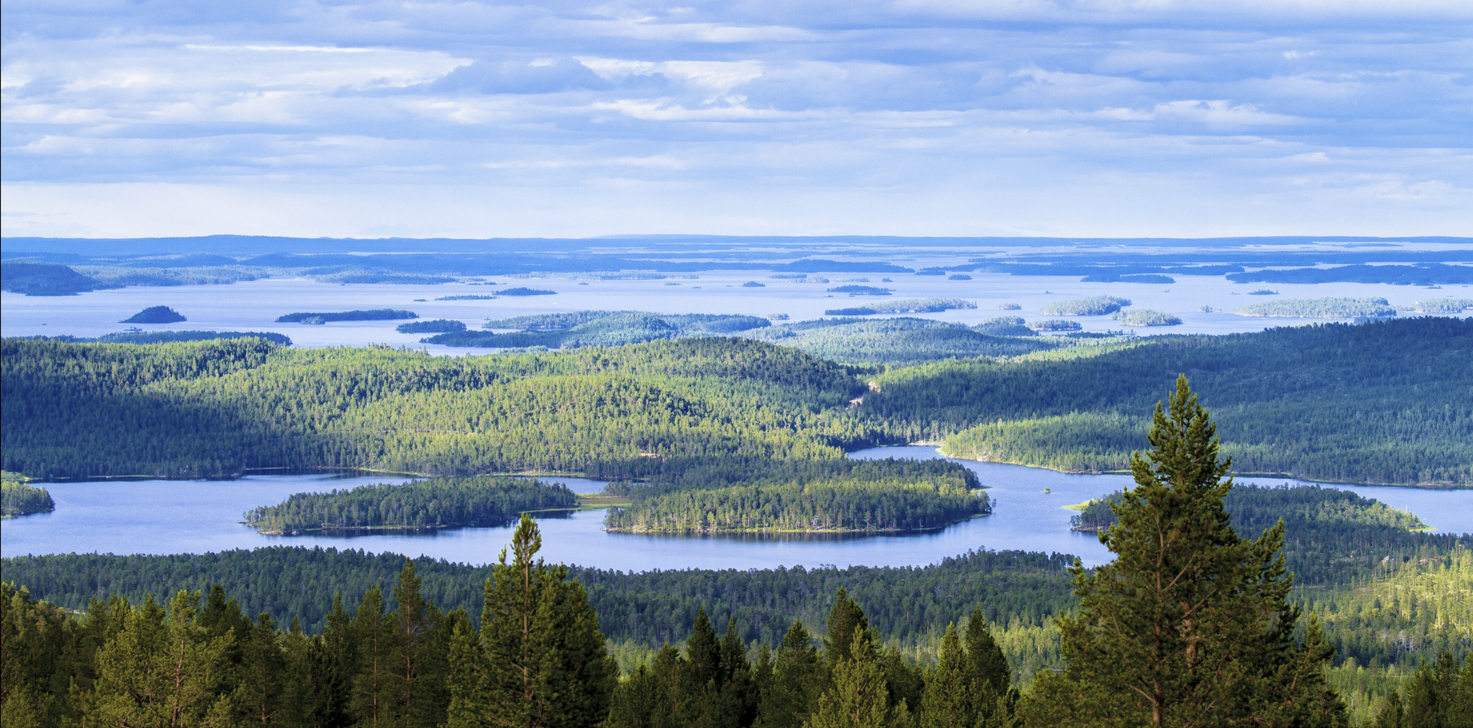
Municipality of Inari – Strategy 2030
Approved by the Council on
11 March 2024 §21

Slide 2
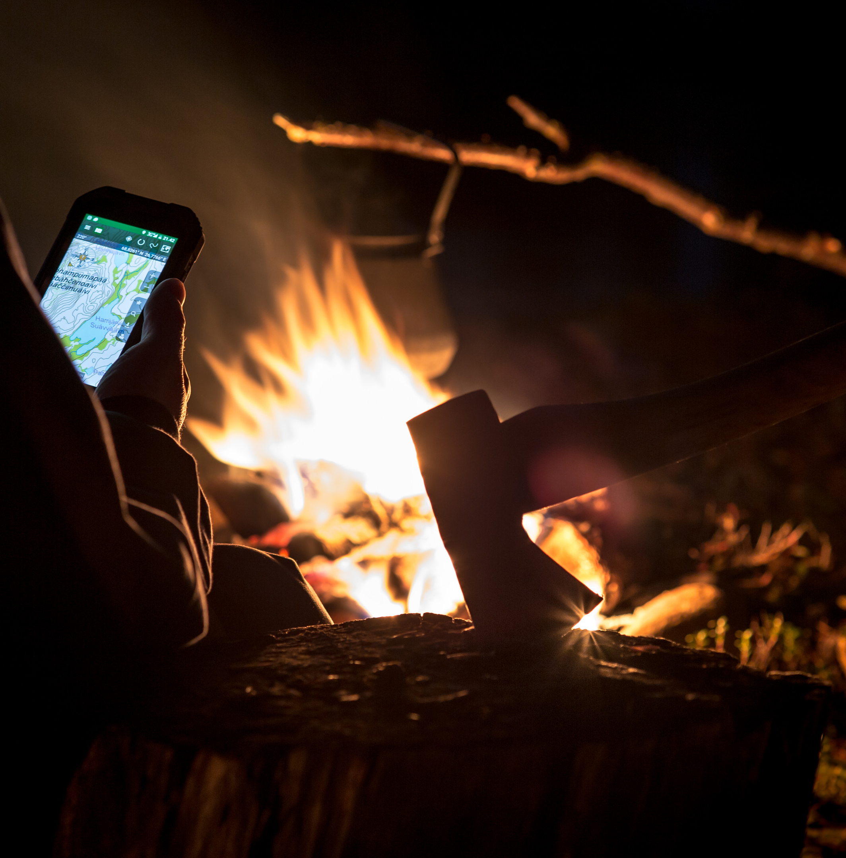

Vision and
Mission
INARI – Mighty by Nature
INARI – A Trusted Steward of Vitality and Wellbeing.

Slide 3


Strategy 2030
  Inari’s unique natural environment is the foundation of all our activities. We harness nature responsibly, fortifying our natural capital.
  The vitality of our municipality rests upon well-managed, evolving industries. We aim to diversify industries and foster year-round economic activity.
  Socially sustainable growth, alongside an understanding of intergenerational significance, is the basis for a good life. We promote community spirit, ensure the safety of residents, and prioritise the wellbeing of children and young people.
  Sámi heritage is a cherished part of Inari’s identity. We work to advance the status of Sámi languages and culture in collaboration with other Sámi Homeland actors.

Slide 4
Our Values
Values | How we bring our values to life
Community-Focused | We act with fairness and treat each other equally In all circumstances, we operate transparently, with a solutions-based approach, and respecting one another We ensure safety throughout the municipality We value family-friendliness, dignified ageing, and a business-friendly environment Our staff actively participates in developing our operations
Local | Local identity is shaped together, encompassing inclusivity and engagement, respect, hospitality, and consideration for others We strive to increase the use of local products and services We seek ways to enhance the value of local products and services Residents and the businesses and communities within the municipality are our most important resources
Bold | We are prepared to make clear and timely decisions We are internationally active We recognise the positives in every situation and courageously seek innovative and practical solutions We encourage bold experimentation and learn from our mistakes We are committed to evolving our municipal organisation to meet future needs
Responsible | We ensure sustainable development for both current and future generations We balance our responsibilities to nature, the local economy, and residents We act responsibly as a decision-maker and employer We keep our promises

Slide 5
Inari – Mighty by Nature
A Responsible Promoter of Vitality and Quality of Life
COMMUNITY-FOCUSED – LOCAL – VISIONARY – RESPONSIBLE
Strategy priorities
NATURE
Sustainable use of nature
VITALITY
Diversification of livelihoods and development of year-round activity
SÁMI CULTURE
Promoting Sámi languages and culture
QUALITY OF LIFE
Socially sustainable growth
Business Development Programme Wellbeing, Health and Safety Programme Language Policy Programme (Sámi Language Strategy) Land Policy Programme
Advocacy Priorities (TOP 8), Impactful Communication

Slide 6
Strategy priorities
Strategy priority | Operational objective | Key measures
NATURE | Sustainable use of nature | Increasing the value of natural capital Responding to climate change Promoting the circular economy Guided and marked trails Sustainable land use
VITALITY | Diversification of livelihoods and increasing year-round activity | Promotion of investments Strengthening and diversifying the economic structure Acquiring a skilled workforce Responsible year-round tourism Nature-based northern livelihoods Effective employment and business services Accessibility
SÁMI CULTURE | Strengthening Sámi languages and supporting cultural promotion | Sámi identity is a precious part of everyday life in Inari Strengthening the visibility of the Sámi languages Improving the availability of Sámi-speaking workers Enhancing services in the Sámi language Good demographic relations Constructive dialogue with Sámi stakeholders
QUALITY OF LIFE | The good life – Socially sustainable growth | Services that work Wellbeing of children and young people Wellbeing and quality of life for the elderly Collaboration with the Lapland Wellbeing Area Intelligent accessibility Supporting villages on their own needs and starting points Carrying out ex-ante evaluation for major projects

Slide 7
Monitoring the strategy
Strategy priority | Operational objective | Monitoring (indicators)
NATURE | Sustainable use of nature | Evolution of recycling rate (%) Relevant sustainability indicators have been introduced in the planning process, Yes/No A climate plan has been drawn up, Yes/No Results of citizen surveys (quality of life and satisfaction with services)
VITALITY | Diversification of livelihoods and increasing year-round activity | Evolution of the municipality’s population (%) Monthly occupancy rate of accommodation capacity (%) Municipal group investment programme based on the vitality programme, Yes/No Results of the Municipal Barometer issued by the Federation of Finnish Enterprises Ecosystem plan for nature-based livelihoods developed, Yes/No
SÁMI CULTURE | Strengthening Sámi languages and supporting cultural promotion | Implementation of state grants in early childhood education and teaching (€/year) Amount of Sámi language education and early childhood education, and Sámi language teaching (actual hours and number of children) Satisfaction with Sámi language services (survey) Expenditure on translations, interpretation, announcements, and communication in euros and personnel resources/year Annual analysis of indicators of the language policy programme (language strategy), Yes/No
QUALITY OF LIFE | The good life – Socially sustainable growth | Evolution of the indicators of the health and wellbeing coefficient (HYTE coefficient) Evolution of the School Health Survey results Percentage of children and young people engaged in hobbies Percentage of children and young people with friends Number of training sessions organised (village safety) Number of pre-decision impact assessments (EVA score)

Slide 8
Advocacy and Influencing TOP 8
1. Promotion of housing and business premises
2. Energy policy (security of supply, new forms of energy, solar power, bio-energy)
3. Promoting year-round tourism and safety, "tourist tax"
4. Promoting multi-location
5. Strengthening funding and activities for Sámi languages and culture
6. Accessibility and transport connections; scheduled air services, functional travel chains, improved bus connections to and within the municipality, regional road 955 and highway 4
7. Regional availability of social and health services
8. Securing functionality and financial viability for the employment and economic areas
The goal of defining the TOP 8 areas in advocacy and influence is to advance strategically important matters for the municipality, summarise the message of the municipality, identify relevant targets for advocacy efforts, and outline specific measures.

Slide 9
Effective communication
Municipal communications, services and decisions
Strategic communication and information, advocacy
Internal communication to staff and group companies
Communication with stakeholders (entrepreneurs, financiers, etc.)
Municipal marketing
The purpose of communication is to communicate the issues of Inari Municipality in an open and positive manner and to maintain constructive and solution-oriented interaction with the residents and various stakeholders.
In marketing the Municipality of Inari, it is essential to raise the profile of the municipality more strongly and make the advantages of Inari’s location more tangible.
An updated communication plan will be drawn up for the different aspects of effective communication, and its implementation will be systematically monitored.

Slide 10

Action Plan 2024–2026 to promote the priorities of the strategy

Slide 11
Nature – Sustainable Use of Nature
Operational objective | Priority measures | Indicators
INCREASING THE VALUE OF NATURAL CAPITAL | Identifying site-specific natural values and interdependencies in decision-making and tendering Implementing land-use planning based on comprehensive nature surveys, participation, safeguarding biodiversity and cultural landscapes Actively exploring alternative long-term solutions for heat production | Competitive tendering with environmental criteria (%) Relevant sustainability indicators have been introduced in the planning process, Yes/No Area coverage of protected areas (square metres) and share of municipal land area
RESPONDING TO CLIMATE CHANGE | Drawing up a climate plan for the municipality Designing environmental construction and maintenance plans based on sustainable development principles (low carbon) Adapting and preparing for climate change locally where possible (floods, snow and rain, severe frost) | A climate plan has been drawn up, Yes/No Evolution of maintenance costs Extreme weather phenomena are taken into account in the contingency plan, Yes/No.
PROMOTING THE CIRCULAR ECONOMY | Increasing recycling rates through active collaboration with Lapin Jätehuolto waste management authority Promoting the efficient use of raw materials Providing guidance and information in collaboration with schools, early childhood education, and waste management authorities | Evolution of recycling rate (%) Development plan in place, Yes/No Awareness-raising activities carried out, number/year
GUIDED AND MARKED TRAILS | Taking into account local needs and customs as well as tourists in nature tourism destinations , preserving unspoilt nature and concentrating routes Guided routes will be implemented to nearby nature sites and nearby recreational areas, taking into account different user needs and accessibility in a variety of ways | Feedback on the condition and maintenance of the routes (summarised after each season) Targeted utilisation rate calculators
SUSTAINABLE LAND USE | Identifying regional characteristics and development needs; Ivalo, Inari and Saariselkä, as well as villages and carrying out regional master plans as a basis for more detailed planning Social sustainability is also taken into account in land use planning throughout the municipality Meeting the needs of business, public functions and residential development through diverse and sustainable land plot supply Updating the Saariselkä land use plan | Results of citizen surveys (quality of life and satisfaction with services) Comparison between completed regional comprehensive assessments and the plan for creating area surveys Saariselkä development plan updated, Yes/No Number of new plots zoned/year Completed construction/year

Slide 12
Vitality – Diversification of livelihoods and increasing year-round activity
Operational objective | Priority measures | Indicators
PROMOTION OF INVESTMENTS | Defining a common vision for targeted investments Promoting investments for residential and commercial properties Increasing the supply of commercial premises and diversifying the use of properties | Municipal group investment programme prepared, Yes/No Number of new building permits issued annually
STRENGTHENING AND DIVERSIFYING THE ECONOMIC STRUCTURE | Supporting business production of local goods and services Attracting new companies to the region, e.g. testing, audiovisual production, assembly or other industrial activities Strengthening cooperation in education and research (e.g. secondary education, universities and research institutes) Using research knowledge for business development | Evolution of business turnover Number of new enterprises established in the municipality/year New openings in educational co-operation
SECURING A SKILLED WORKFORCE | Identifying labour needs and ensuring the sustainability of the workforce Increasing the number of jobs created around the Sámi languages and the number of people with Sámi language skills Developing housing and service solutions for employees Targeting municipal marketing towards returning residents | Evolution of the municipality’s population (%) Number of employees receiving the language allowance Number of people on the housing waiting list
RESPONSIBLE YEAR-ROUND TOURISM | Promoting year-round tourism and extending stays Developing responsible and climate-smart tourism services and structures (including trails and events) Supporting tourism marketing and developing cooperation in the tourism sector | Duration of stay Monthly occupancy rate of accommodation capacity (%) Initiatives supporting sustainable tourism
NATURE-BASED NORTHERN LIVELIHOODS | Building an ecosystem for nature-based industries (reindeer, fishing, natural products, handicrafts, wellbeing) Increasing product upgrading and utilising opportunities of the circular economy Promoting business and testing activities that take advantage of northern natural conditions | Ecosystem plan for nature-based livelihoods developed, Yes/No Degree of processing of products Number of development projects
EFFECTIVE EMPLOYMENT AND BUSINESS SERVICES | Conceptualisation of business services and development of network cooperation (business associations, advisory organisations and financiers) Providing advisory services for start-ups and developing businesses Enhancing workforce services | Net number of enterprises Vitality agreement with the entrepreneur organization, Yes/No Results of the Municipal Barometer issued by the Federation of Finnish Enterprises Amount of business aid applied for (€)
ACCESSIBILITY | Increasing the number of scheduled flights Promoting responsible travel chains Improving telecommunications connections | Number of direct flights Phone and Internet coverage

Slide 13
Sámi – Strengthening Sámi languages and supporting cultural promotion
Operational objective | Priority measures | Indicators
SÁMI IDENTITY IS A PRECIOUS PART OF EVERYDAY LIFE IN INARI | Presenting Sámi culture as part of everyday life in Inari from childhood onwards Information about Sámi and Sámi-speaking services in external communication, staff orientation andinformation for new residents | Number of participants/year in Sámi cultural and Sámi language events organised in the municipality Availability of orientation materials, Yes/No
STRENGTHENING THE VISIBILITY OF SÁMI LANGUAGES | Enhancing the visibility of Sámi culture and languages (including physical signage and online communication) Systematic increase of Sámi-language communication, such as interpretation services for Sámi languages during Council meetings | Measures taken/year Funds and personnel resources allocated per year for translations, interpretation, announcements, and communications Number of individuals reached through Sámi-language interpreted Council streams per year
IMPROVING THE AVAILABILITY OF SÁMI-SPEAKING EMPLOYEES | Developing the recruitment of Sámi-speaking employees together with the Sámi Parliament Ensuring availability and retention of Sámi-speaking employees through good working conditions and language support Motivating employees to engage in language training and motivating young people to engage in early childhood education and basic education Inari Municipality’s attraction and retention of Sámi-speaking employees Mentioning the Sámi language supplement in job advertisements | Applicants per vacant Sámi-speaking (eligibility criteria) job vacancy Percentage of Sámi-speaking employees (language supplement) in the municipality
ENHANCING SERVICES IN SÁMI LANGUAGES | Securing early childhood education and basic education in Sámi and Sámi upper secondary education and their funding – the municipality has an important role to play in securing the future of endangered languages Services in Sámi language and culture, seeing Sámi as an asset Active engagement with Sámi stakeholders to secure funding for statutory services Promotion of Sámi leisure activities in cooperation with other actors | Implementation of state grants in early childhood education and teaching (€/year) Amount of Sámi language education and early childhood education, and Sámi language teaching (actual hours and number of children) Satisfaction with Sámi language services (survey) Analysis of language policy program (language strategy) indicators annually, Yes/No.
GOOD DEMOGRAPHIC RELATIONS | Fostering a safe, open, and learning-oriented discussion atmosphere together Building trust together | Results of the equality survey by term of Council
CONSTRUCTIVE DIALOGUE WITH SÁMI STAKEHOLDERS | Facilitating dialogue between the municipality and the Sámi Parliament – developing joint advocacy and cooperation Establishing natural pathways and regularity in collaboration with Sámi stakeholders, including the Sámi Parliament, the Sámi Education Centre, and Siida, and also ensuring cooperation with the Lapland Welfare Region | Regular contact meetings/year Common engagement measures per year

Slide 14
The good life – Socially sustainable growth
Operational objective | Priority measures | Indicators
FUNCTIONING SERVICES | We maintain strong basic services In services and customer guidance, we use understandable language and avoid using complex professional terms We prepare service concepts for the villages We invest in the wellbeing of the municipal staff | Satisfaction with services (annual survey) – evolution of ratings Development of HYTE-factor indicators Qualification of teaching staff (%) Have two village service concepts been made annually? Yes/No Monitoring sick leave of staff
WELLBEING OF CHILDREN AND YOUNG PEOPLE | We support the holistic wellbeing and developmental prospects of children and young people We work actively with other authorities and organisations to provide early support for children and families Our endeavours include the refined advancement of the Finnish Model of recreation, contextualised within the framework of Inari Municipality We systematically enhance recreational infrastructure | Evolution of the School Health Survey results Percentage of children and young people engaged in hobbies Percentage of children and young people with friends Recreational facilities development plan in place, Yes/No
WELLBEING AND QUALITY OF LIFE FOR THE ELDERLY | We promote the wellbeing and quality of life of older people We maintain the conditions for action through activities, facilities and participation We encourage the construction of accessible housing | Proportion of older people who consider their quality of life good (%)
COLLABORATION WITH THE LAPLAND WELLBEING REGION | We build cooperation and effective interfaces with the activities of the Lapland Wellbeing Region Our collaborative efforts are dedicated to the enhancement of wellbeing, health, and safety We monitor our interests in access to services | Evaluation of the effectiveness of cooperation with the wellbieng region (survey) Development of HYTE index indicators
INTELLIGENT ACCESSIBILITY | We promote passenger transport opportunities We coordinate service transport and school transport We actively improve telecommunications | Number and occupancy rate of transportation services and combined transportation Transportation facilities development plan in place, Yes/No Internet coverage
SUPPORTING VILLAGE COMMUNITIES | Profiling villages based on their own needs and circumstances We elevate the visibility of villages and foster village collaboration We update village safety plans We improve first-aid and fire-fighting capacity in villages | Number of training sessions organised (village safety)
IMPLEMENTATION OF PRE-ASSESSMENT IN MAJOR PROJECTS | We proactively assess the impact of major projects on the local community | Number of pre-decision impact assessments carried out (EVA score)

Slide 15


